Slide 1
Renewable Solar Energy

Slide 2

Introduction
Team Members: Ryan Furnish, Qusai Hadidi, and Fadad Aljama
Audience: Large Companies such as Caterpillar
Renewable Solar Energy

Slide 3
Problem
More reliable energy sources.
Fossil fuels are the major source of energy
Fossil fuels are exhaustible
Increasing cost of energy

Slide 4
Problem Statement
Non-renewable sources of energy such as petroleum based energy are exhaustible and expensive in long term as compared to renewable sources of energy.

Slide 5
Purpose
The purpose of the report is to determine the cost benefits of solar energy and the advantages of solar energy when supplemented with existing power supply on a daily bases.

Slide 6
Scope
The report focuses on the cost, benefits, storage, and usage of solar energy as a source of energy for major companies with large electricity demands.

Slide 7
RESULTS

Slide 8
Discussion
Retrieved data

Slide 9
Cost Benefits of Solar Energy
The capital
The capital costs are approximated to be $400/M².
two companies that generate electricity in Hong Kong.
Table

Slide 10
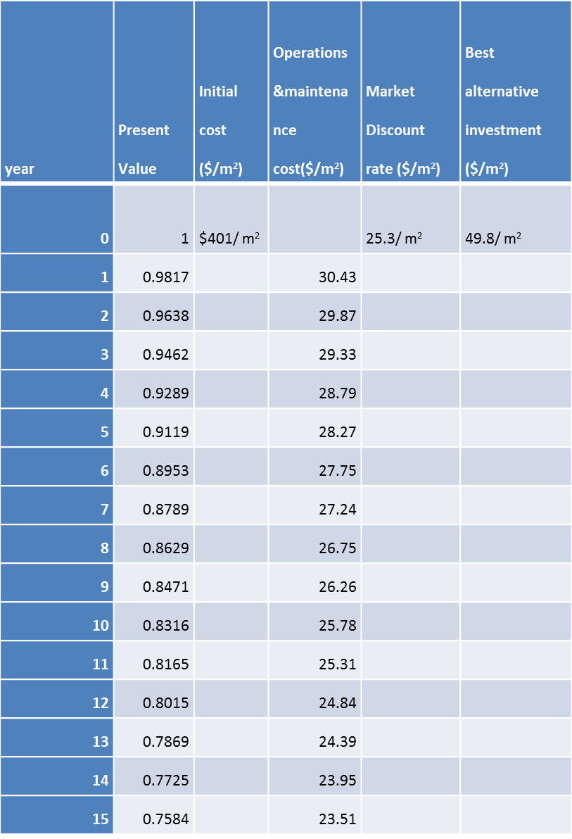

Slide 11
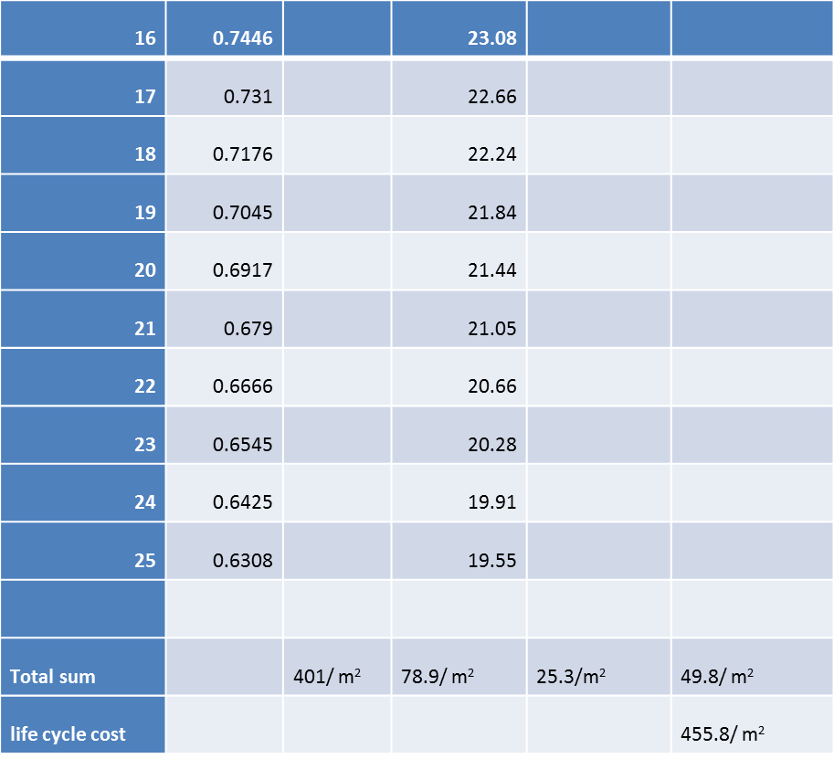

Slide 12
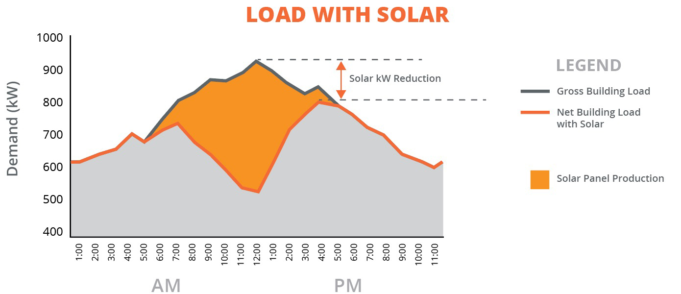
Advantages of Solar Energy
Supplementing power usage with energy collected from solar panels can greatly reduce energy costs.
Energy can be stored on batteries and can be used when solar panel production is not at its highest.

Slide 13
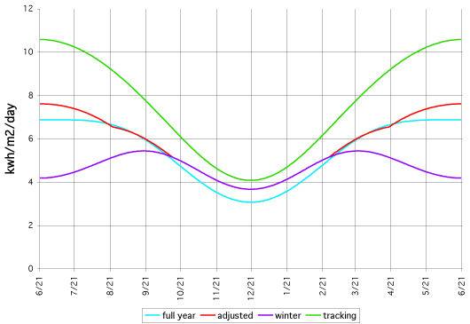
Solar Panel Systems
There are three different types of solar panels systems.
Fixed panels that are left in the same position year long.
Adjustable panels that are manually adjusted twice a year for increased efficiency.
Tracking systems that will move panels to face the sun throughout the day.
Solar Production by Month

Slide 14
Conclusion
Renewable energy
In the past solar energy was costly and inefficient to collect on a large scale.
Advances in solar energy sources
The initial cost of these systems are high
Government tax credits and incentive

Slide 15
Recommendations
Caterpillar can successfully supplement energy demands and reduce energy costs for the company.
Doing so will reduce the environmental impact Caterpillar has and increase the public’s view of the company.

Slide 16
References
Anyu, J. N. (2017). Solar Energy from the Sahara Sun to Power Europe: The Deserted Project. International Journal of Organizational Innovation, 9(3), 56-70.
Mingaleva, Z., Vukovic, N., & Radovanovic, M. (2017). Solar energy application in houses heating systems in Russia. International journal of cognitive research in science, engineering & education (IJCRSEE), 5(1), 141-148. Doi: 10.5937/IJCRSEE1701141M
Smith, M. G., & Urpelainen, J. (2014). Early Adopters of Solar Panels in Developing Countries: Evidence from Tanzania. Review Of Policy Research, 31(1), 17-37. doi:10.1111/ropr.12061
Danielson, M. G. (2016). The IRR of a project with many potential outcomes. Engineering Economist, 61(1), 44-56. doi:10.1080/0013791X.2015.1095383
Kaufman, D., and C. Franz. (2000). Biosphere 2000: Protecting Our Global Environment. New York: Harper.

Slide 17
Continuation
Augustine Band of Cahuilla Indians, Energy Conservation and Development Project—Energy Options Analysis. (2005). Award No. DE-FG36- 0XGO16018, Final Report.
Simionescu, M. (2016). The identification of inflation rate determinants in the USA using the stochastic search variable selection. Centre for european studies (ces) working papers, 8(1), 171-181.
Stahley B. (2017, April 11th) Everything you need to know about commercial solar battery storage in 1,000 words (and 3 pictures). http://businessfeed.sunpower.com/articles/introduction-to-commercial-solar-battery-storage
Elisara-Laulu, F. M. (2009). “Report on the Indigenous Peoples Global Summit on Climate Change—Dena’ina Center Anchorage Alaska.” Available at: http://siosiomaga.hostoi.com/reports/meeting%20reports/ IP_Anchorage_2009.htm.
Dreveskracht, R. D. (2013). Economic development, native nations, and solar projects. American Journal of Economics & Sociology, 72(1), 122-144. doi:10.1111/j.1536-7150.2012.00866.x

